Slide 1

Playing around with React Testing Library
By: Alfred Glickman

Slide 2
Who am I
Alfred Glickman
Front End Developer on NAB Chatbot
Startup Enthusiast
React Fan
A pretty average tester

Slide 3
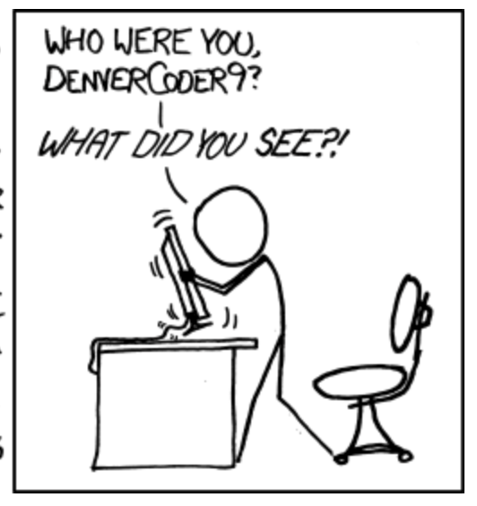
Why Unit Test?
Because the lead/client said 99% coverage or else! 😅
Quality! ☺️
Helps you define the problem and see any gaps. Nobody is perfect but we get closers when we test.
Good for keeping track of agile and complex applications.
Better integration and fault isolation. 🙅‍♂️
Faster debugging and development. 🏎
I can’t remember what I did 2 hours ago, let alone last month. 🐟
Find bugs now or at 2am when the manager calls you about a production defect.
Because JS will always find a way to surprise you. 😱

Slide 4
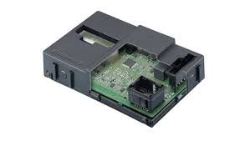
What’s a Unit Test, really?
A benchmark for piece of code or a component.
Documentation for who this code is supposed to be used.
Captures certain assumptions made during development as well as an understanding of requirements…
Does it mean that the system is perfect? No way!
Does 100% coverage guarantee that the system is perfect? No way!
Hardware Unit Tester
Body Control Module

Slide 5
Testing for dummies
A good unit test:
Arrange a situation – prepare mocks, initialise components and etc
Act - make the component do something
Assert – check that what you expect to happen, has happened.
Part of this nutritious testing regiment:
End to end testing – Cypress / Webdriver – automated click testing
Integration testing – Mountebank / Postman / Jest – automated testing that ensures that components work well together.
Unit testing – Individual component testing
Static testing – Lint and etc – Can’t live without it 😅

Slide 6
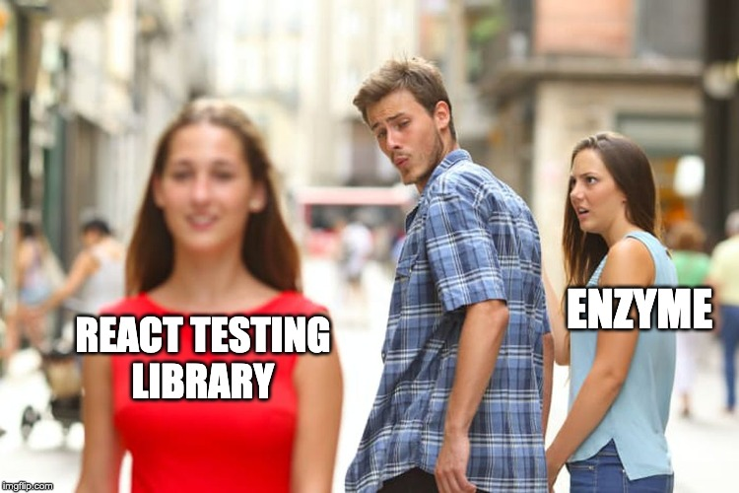
Why another FE unit test library?
An alternative to the popular Enzyme test library from AirBNB.
React Testing Library’s Guiding Principle:
“ The more your tests resemble the way your software is used, the more confidence they can give you.”
Don’t test actual implementation and component state, instead; operate on the actual component’s DOM as it is rendered.
I’d call it black box testing 🤔

Slide 7

What is RTL?
Library created by: Kent C. Dodds (who is also selling a testing course here: https://testingjavascript.com/)
Site: https://testing-library.com/docs/react-testing-library/intro
Git: https://github.com/testing-library/react-testing-library
Built on top of the dom-testing-library
Grouped in a family of DOM testing packages: @testing-library which supports 11 different FE frameworks such as: Angular, Svelte and React
Doesn’t offer test execution, reporting, coverage or assertions functionality. Still need to use Jest for that
Kent C. Dodds
(Dan Abramov 2.0)

Slide 8
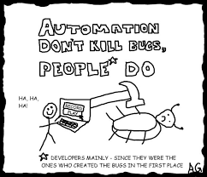



The basics…
Oh, so simple.
Step 1: Install
Step 2: Render your component to obtain a query object. Destructure some useful methods:
Query DOM using label text (as a user would)
Or use “data-testid” special hidden attribute 🤞

Slide 9
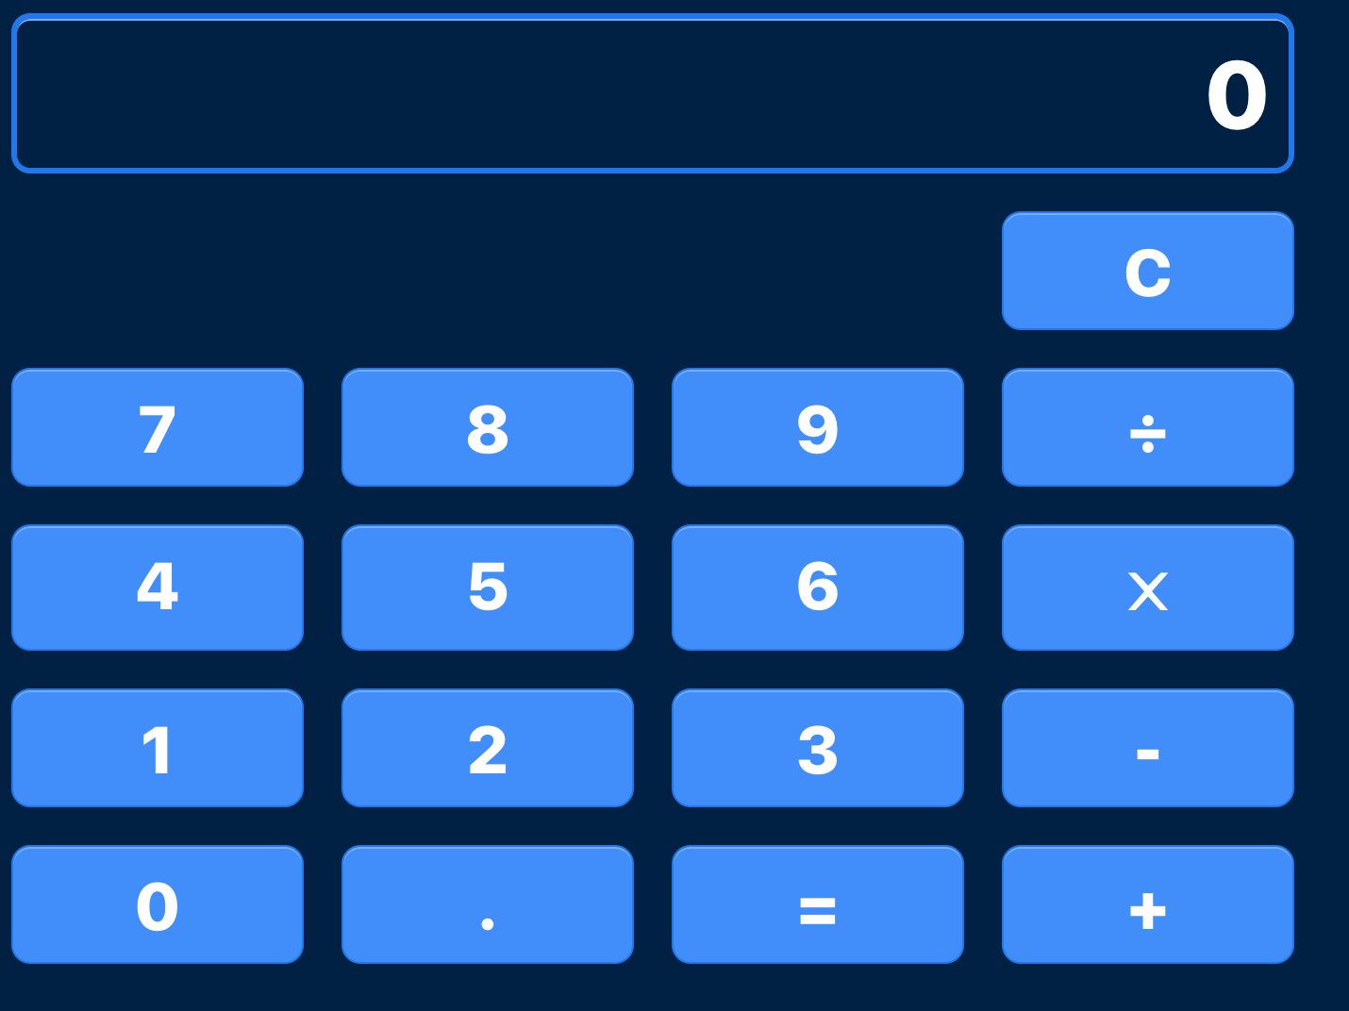
Example using JEST
A simple component:

Slide 10
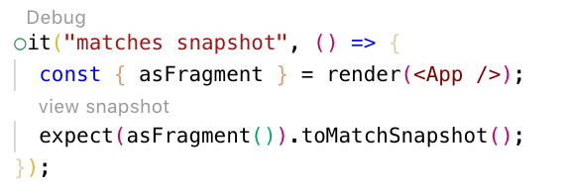
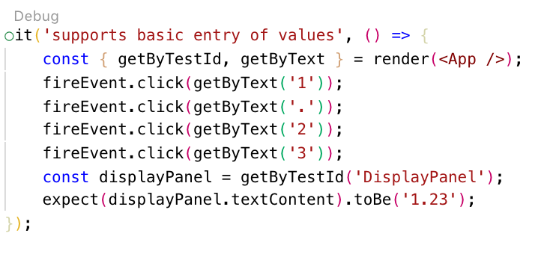
Lets get testing
Snapshots:
Type something:

Slide 11
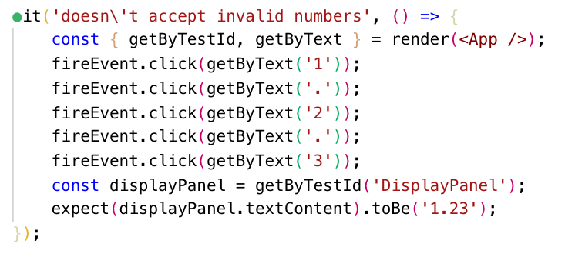
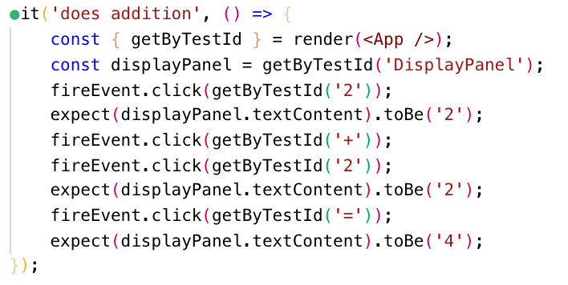
Lets test
Negative scenario:
Addition:

Slide 12
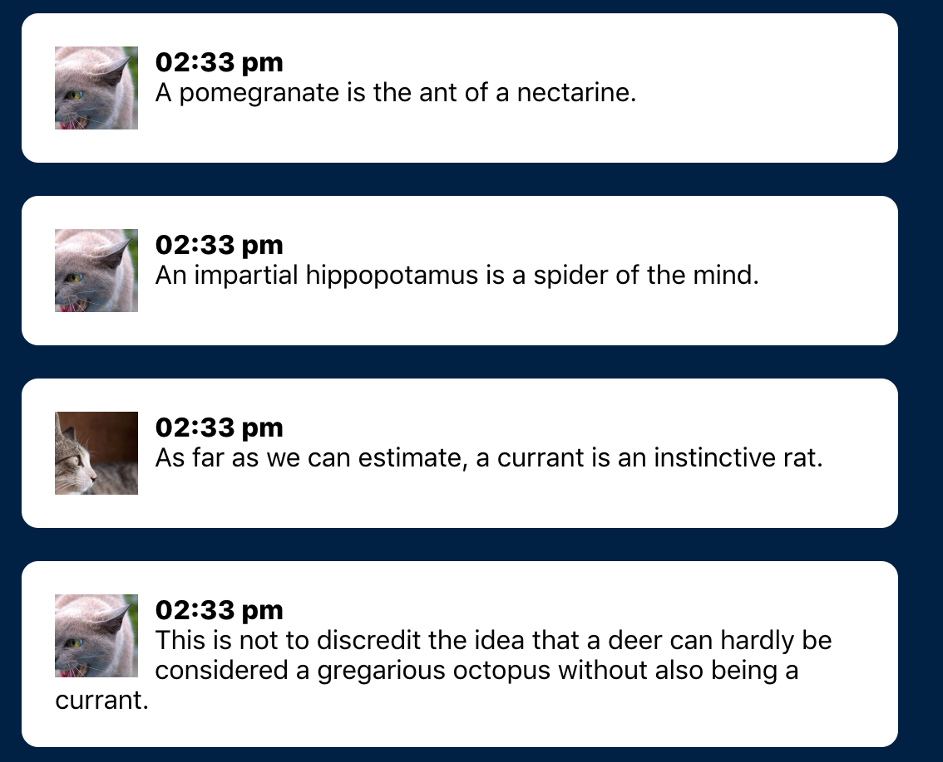
Waiting for DOM nodes
Cat Chat

Slide 13
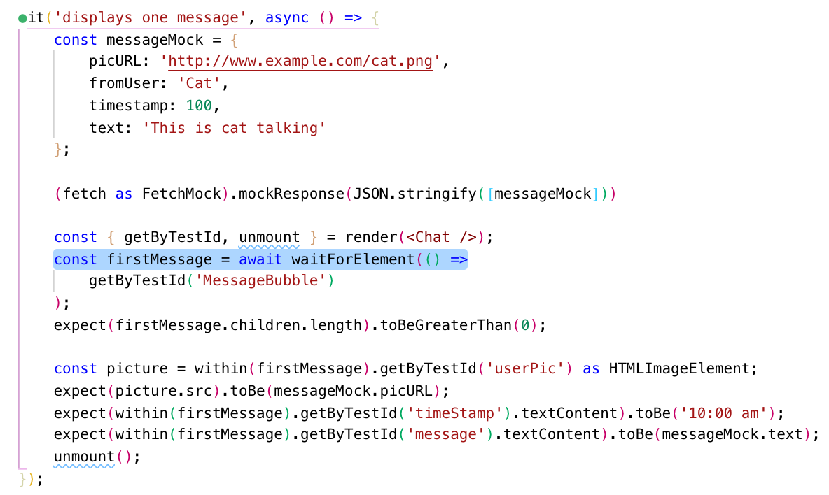
Waiting for DOM nodes

Slide 14
Selectors
Selectors | Description
getByLabelText | Good for forms
getByPlaceholderText | In case you don’t use labels 😅
getByText | Good for free form text
getByDisplayValue | Just use the value
getByAltText | Using the “alt” attribute
getByTitle | Accessibility attribute
getByRole | Good for dialog boxes
getByTestId | A special non rendered attribute “data-testid”
querySelector | When all else fails, just use the DOM API selectors

Slide 15
Pros and Cons
Pros:
Simple set of methods
Renders proper components
Easy event triggering and waiting for changes
Lots of nice selectors
Good set of recipes: https://testing-library.com/docs/recipes
Cons:
No Shallow Rendering – need to mock child components
Less extensive query options than Enzyme
Less help available on the web

Slide 16
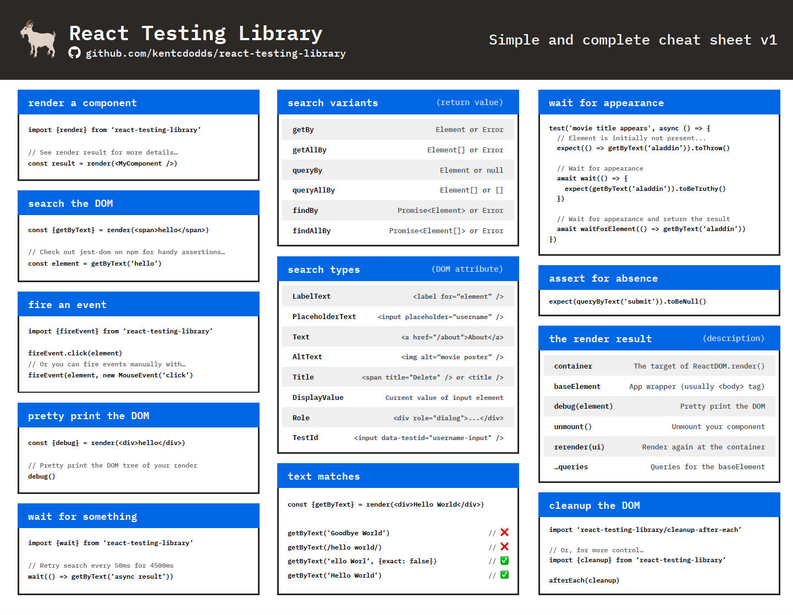
Useful Cheat Sheet
https://testing-library.com/docs/react-testing-library/cheatsheet

Slide 17
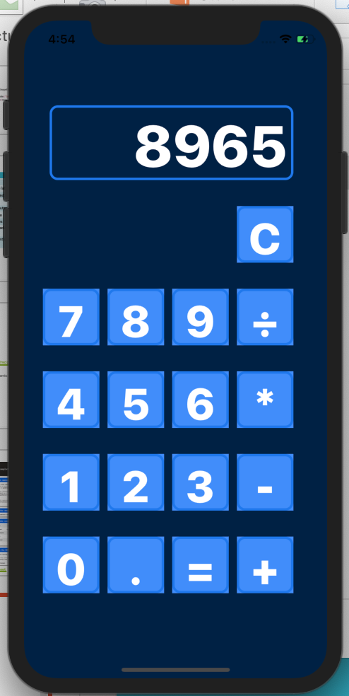
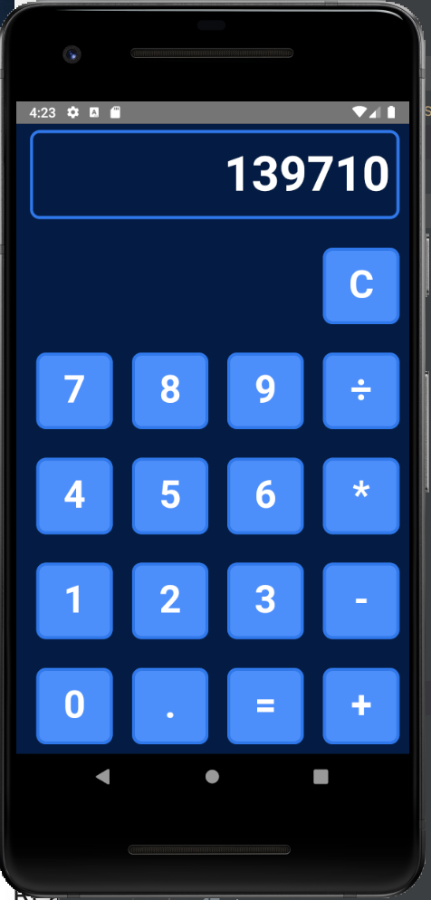
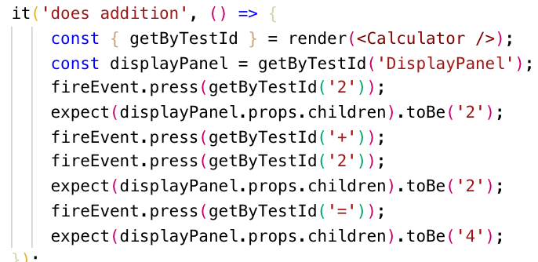
React Native version
@testing-library/react-native -
https://www.npmjs.com/package/@testing-library/react-native
Slight differences but largely similar tests

Slide 18
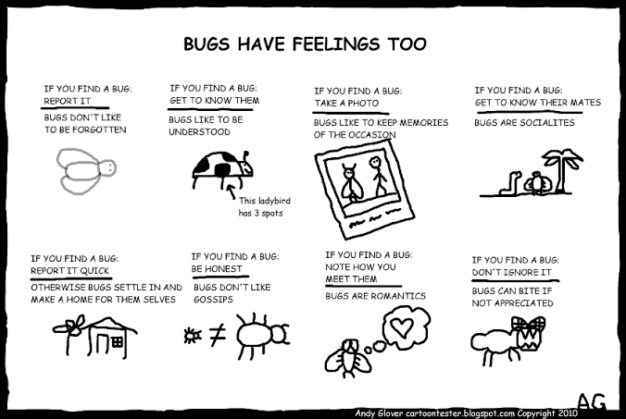
Thank you
Keep on testing…

